Slide 1
Tangshan, China 1976 Earthquake
Human Toll 1

Slide 2
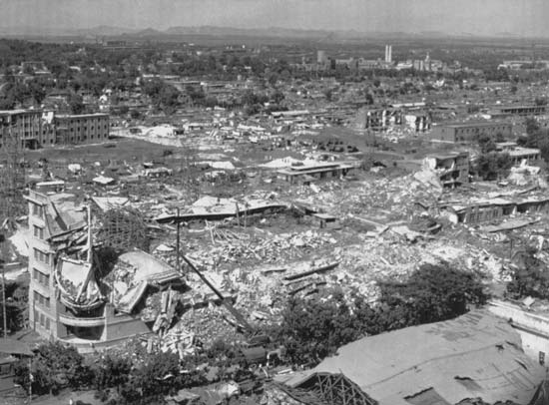
Economic Impacts
93% of residential buildings and 78% of residential buildings in Tangshan were destroyed. [2]
80% of water pumping stations were seriously damaged [2]
10 billion yuan in estimated damages. [3] That’s roughly $1.6 billion dollars
The earthquake leveled entire cities. [4]
Figure 1

Slide 3
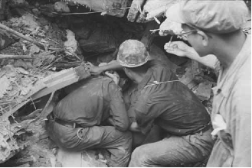
Casualty Statistics
Greatest death toll from an earthquake in the last 400 years. [1]
Second greatest death toll from an earthquake in recorded history. [1]
Official: 240,000 people killed. [1]
Unofficial estimates at 655,000 people killed. [1] Some estimates as high as one million. [4]
Over 799,000 injured [1]
In 7,218 households, all members of the family were killed [1]
Figure 2

Slide 4
Bibliography
Figure 1 - http://media-1.web.britannica.com/eb-media/06/118106-004-E088594E.jpg
Figure 2 - http://3.bp.blogspot.com/_fZjDYaU39Vs/R1K6MyLXgGI/AAAAAAAAAA0/UoDABqRcJNo/s1600-R/e6.png
[1] Unknown. (Unknown). Historic Earthquakes Tarshan,China. Retrieved from https://app.box.com/embed/preview/ryxink1a4rxj437pq0ngxefo4388bf82?theme=dark
[2] [1] Wang ,F., (unknown) . The 1976 Tangshan Earthquake. Retrieved from https://app.box.com/embed/preview/ryxink1a4rxj437pq0ngxefo4388bf82?theme=dark
[3] Stoltman, Joseph P. Lidstone, John. Dechano, M. Lisa. [2004] (2004). International Perspectives On Natural Disasters. Springer publishing. ISBN 1-4020-2850-4
[4] Ricks, R. (10/1/2015). Put into your own words and insert it in the. Retrieved from https://byui.brainhoney.com/Frame/Component/CoursePlayer?enrollmentid=34478216

